Slide 1
Data Sufficiency

Slide 2
Anatomy of a Data Sufficiency question:
While the genre of Data Sufficiency is unique, the structure is not – all Data Sufficiency questions are structured exactly the same, with three key elements:
Consider this example to see what a Data Sufficiency question will look like:
QUESTION STEM
By what percent was the price of a certain candy bar increased?
STATEMENTS
The price of the candy bar was increased by 5 cents.
The price of the candy bar after the increase was 45 cents

Slide 3
ANSWER CHOICES:
Statement (1) ALONE is sufficient, but statement (2) alone is not sufficient.
Statement (2) ALONE is sufficient, but statement (1) alone is not sufficient.
EACH statement ALONE is sufficient.
BOTH statements TOGETHER are sufficient, but NEITHER statement ALONE is sufficient.
Statements (1) and (2) TOGETHER are NOT sufficient.
If you’re relatively new to Data Sufficiency, the most striking feature of this question is likely the answer choices – they’re not numbers that might answer the questions, they’re more logical descriptions of when you might be able to answer the question.
In this you just need to check that are we able to reach out to an answer. From both the statements answer might be different.

Slide 4
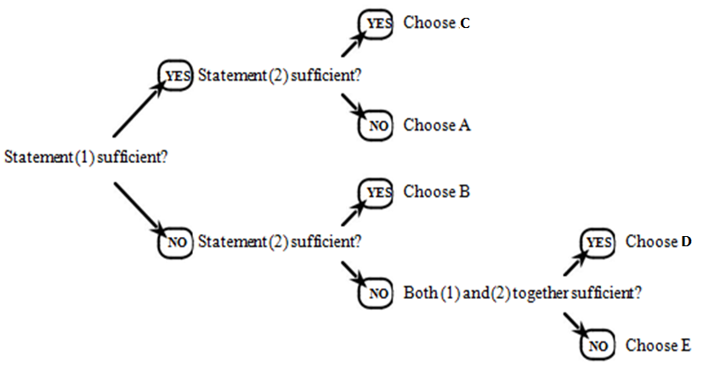
Data Sufficiency Decision Tree:
Assess each statement to determine whether it is sufficient or not, and this tree will lead you to the correct answer:

Slide 5
PRACTICE QUESTIONS:
Each problem consists of a question and two statements, labeled (I) and (II), in which certain data are given. You have to decide whether the data given in the statements are sufficient for answering the question.
Mark,
A. If statement (i) ALONE is sufficient, but statement (ii) alone is not sufficient to answer the question asked.
B. If statement (ii) ALONE is sufficient, but statement (i) alone is not sufficient to answer the question asked.
C. If EACH statement ALONE is sufficient to answer the questions asked.
D. If BOTH statements (i) and (ii) TOGETHER are sufficient to answer the question asked, but NEITHER statement ALONE is sufficient
E. If statements (i) and (ii) TOGETHER are NOT sufficient to answer the question asked and additional data specific to the problem are needed.

Slide 6
1. Question: In which year was Rahul born ?
Statements:
Rahul at present is 25 years younger to his mother.
Rahul's brother, who was born in 1964, is 35 years younger to his mother.
2. Question: What will be the total weight of 10 poles, each of the same weight ?
Statements:
One-fourth of the weight of each pole is 5 kg.
The total weight of three poles is 20 kilograms more than the total weight of two poles.
3. Question: How many children does M have ?
Statements:
H is the only daughter of X who is wife of M.
K and J are brothers of M

Slide 7
4. Question: How much was the total sale of the company ?
Statements:
The company sold 8000 units of product A each costing Rs. 25.
This company has no other product line.
5. Question: The last Sunday of March, 2006 fell on which date ?
Statements:
The first Sunday of that month fell on 5th.
The last day of that month was Friday.
6. Question: What is the code for 'sky' in the code language ?
Statements:
In the code language, 'sky is clear' is written as 'de ra fa'.
In the same code language, 'make it clear' is written as 'de ga jo'.

Slide 8
7. Question: How many children are there between P and Q in a row of children ?
Statements:
P is fifteenth from the left in the row.
Q is exactly in the middle and there are ten children towards his right.
8. Question: How is T related to K?
Statements:
R's sister J has married Ts brother L, who is the only son of his parents.
K is the only daughter of L and J.
9. Question: How is J related to P ?
Statements:
M is brother of P and T is sister of P.
P's mother is married to J's husband who has one son and two daughters.

Slide 9
10. Question: Who is to the immediate right of P among five persons P, Q, R, S and T facing North ?
Statements:
R is third to the left of Q and P is second to the right of R.
Q is to the immediate left of T who is second to the right of P.
11. What is the rate of interest p.a on an amount of Rs. 12000 deposited in a bank?
I. The difference between the simple interest and the compound interest is Rs 172.8.
II. The simple interest for two years is Rs. 2880.
12. What is the profit earned by selling the laptop for Rs 26,250?
I. The cost price of five such laptops is equal to selling price of 4 such laptops.
II. 25% of the profit is earned by selling each laptop.

Slide 10
13. How many women can complete a piece of work in 15 days?
I. If 12 women can complete the same piece of work in 20 days.
II. If 10 men can complete the same piece of work in 12 days.
14. Question: How is F related to P?
Statements:
P has two sisters M and N.
F's mother is sister of M's father.
15. What is the age of C in a group of A, B, C, D and E whose average is 45 years?
I. Average of the ages of A and B is 53.
II. Average of the ages of D and E is 47.

Slide 11
16. In a library 10% of the books are added every year, what was the number of books that the library had in 1994?
I. During 1996, 10,000 books were added
II. During 1995, the library had 1,00,000 books
17. Question: B is the brother of A. How is A related to B ?
Statements:
A is the sister of C.
E is the husband of A.
18. D is the sister of C. how is D related to A?
I. A is the sister of B
II. B is the brother of C
19. A, B,C,D and E are sitting in a row. What is the position of B from the left end?
I. A is sitting at one end second right of D who is the immediate neighbor of C and B
II. E is to the left of B

Slide 12
20. Question: How is 'No' coded in the code language ?
Statements:
'Ne Pa Sic Lo' means 'But No None And' and 'Pa Lo Le Ne' means 'If None And But'.
'Le Se Ne Sic' means 'If No None Will' and 'Le Pi Se Be' means 'Not None If All'.
21. What will come in place of c in the series a,b,c,d,e?
I. a,b,c,d,e are five consecutive even numbers
II. common difference between two consecutive numbers is 2 and a is the second smallest natural number
22. Question: Which code word stands for 'good' in the coded sentence 'sin co bye' which means 'He is good' ?
Statements:
In the same code language, 'co mot det' means 'They are good'.
In the same code language, 'sin mic bye' means 'He is honest'.

Slide 13
23. Question: Among P, Q, R, S and T, Q is the second tallest and S is immediate taller than the shortest. Who among them is in the middle when they stand in the order of their heights ?
Statements:
I. T is not the shortest.
II. R is taller than S but shorter than Q.
III. P ranks third in height above S when all are arranged in the order of height.
Only I and II
Either II only or I and III only
Only II
Only II and III
None of these

Slide 14
24. Question: Four subjects - Physics, Chemistry, Mathematics and Biology - were taught in four consecutive periods of one hour each starting from 8.00 a.m. At what time was the Chemistry period scheduled ?
Statements:
I. Mathematics period ended at 10.00 a.m., which was preceded by Biology.
II. Physics was scheduled in the last period.
III. Mathematics period was immediately followed by Chemistry.
Only I
Either I only or II only
Only II
Only II and III
Only I and either II or III

Slide 15
25. Question: What is the total monthly salary of Vasu ?
Statements:
I. Vasu's basic salary is Rs 100 more than Rajan's salary who also serves in Vasu's company.
II. Other allowances drawn by Rajan besides his basic salary are Rs 2000 per month which is Rs 50 less than Vasu's salary.
III. Rajan's basic salary is Rs 1550 per month,
Only II
Only II and III
Only I and II
Only I and III
All I, II and III

Slide 16


